Slide 1





STROOP
Junior Cycle Modern Foreign Language
Target Language - German
Strand 1 & 2 - Communicative Competence & Language Awareness
Element - Spoken interaction & reflecting on how the target language works
Learning Outcomes - 1.15 & 2.2
Simon Green
challengingideas.co.uk

Slide 2
The Stroop Effect
Instruction:
Tell me only the COLOUR you see
not what the WORD says
HEKKY

Slide 3
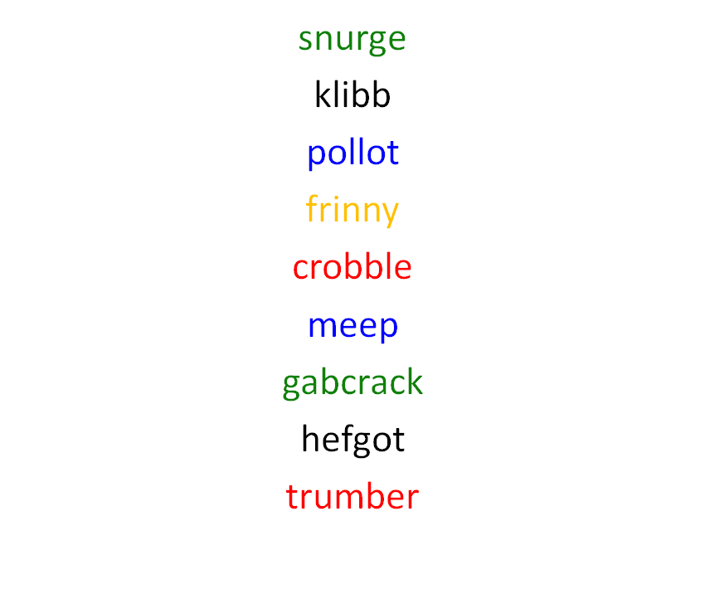

Slide 4
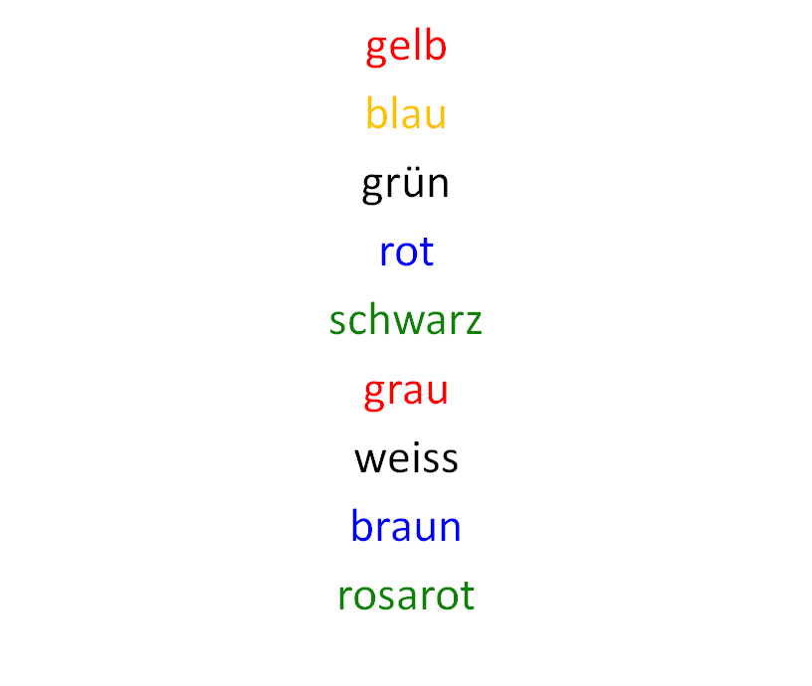
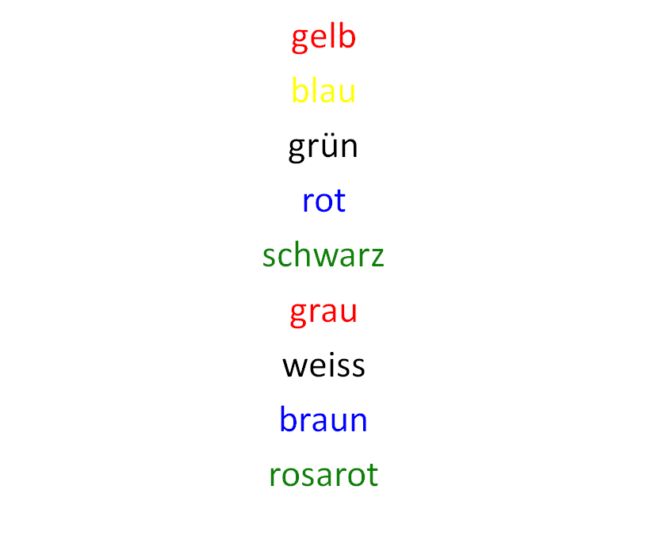

Slide 5
STROOP
Follow us @ScoilnetPPrim

